Slide 1


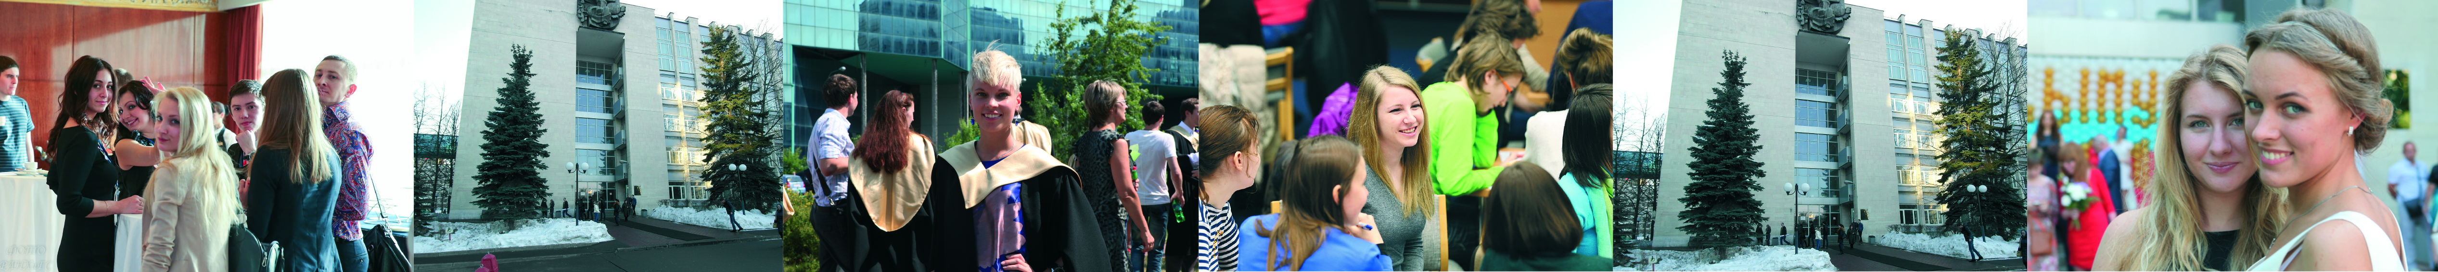




Рабочая группа ООН PRME по устойчивому сознанию: передовой опыт глобального сообщества инженеров человеческих душ
Екатерина Иванова
16 октября 2018, Москва

Slide 2
What to Expect from this Talk?
What? A personal story of becoming an “Educator 2.0”
Why? To give back and share best practices
How? Highlights on key tools, trends, experts, communities + Q&A + presentation
So what? To confirm that Sustainability & Humanistic Management can contribute to awakening and a big shift in modern business education
2
Dr. Ekaterina Ivanova – LEAP, UN PRME Working Group on Sustainability Mindset

Slide 3
WHAT?
Екатерина Иванова
16 октября 2018, Москва

Slide 4
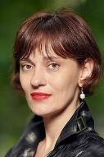






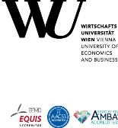



















My Personal Way to CSR & Sustainability
Ekaterina Ivanova
Always at the forefront of Business & Society
From
16
Visiting Lecturer,
Humanistic Mgmt:
Sustainability Mindset
09 – 16
Assistant Professor, Post Doc
Research Associate, Prea Doc
Doctoral Program, Cum Laude
02 – 09
Director, Research
Director, Events
Director, Committees
Global experience across multiple cultures
Core professional strengths & networks
Exchange Student & Academic Fellow
15+ years of applied and academic research in CSR,
business ethics, nonprofits & experiential learning
Leadership roles in complex international projects
Innovative teaching approaches for BSc and MSc students
Strong global professional network, active member of
AoM, ISTR, LEAP - UN PRME, FLEX alumni club
Inspiring blogger on Twitter, LinkedIn & Facebook
Professional Career & Entrepreneurship
Academic Career & Residence
4
Dr. Ekaterina Ivanova – LEAP, UN PRME Working Group on Sustainability Mindset

Slide 5
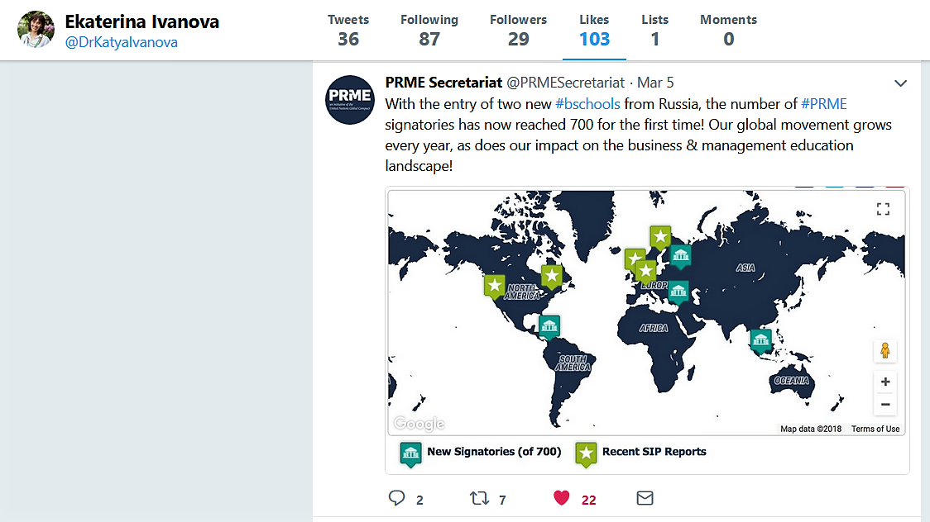
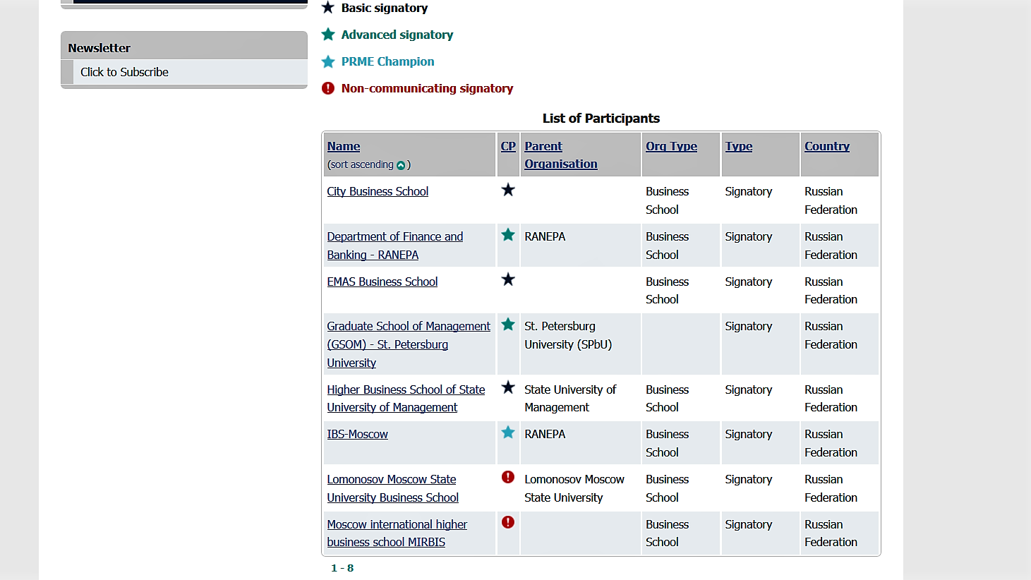
IBS RANEPA – the Only PRME Champion from Russia
Dr. Ekaterina Ivanova – LEAP, UN PRME Working Group on Sustainability Mindset

Slide 6

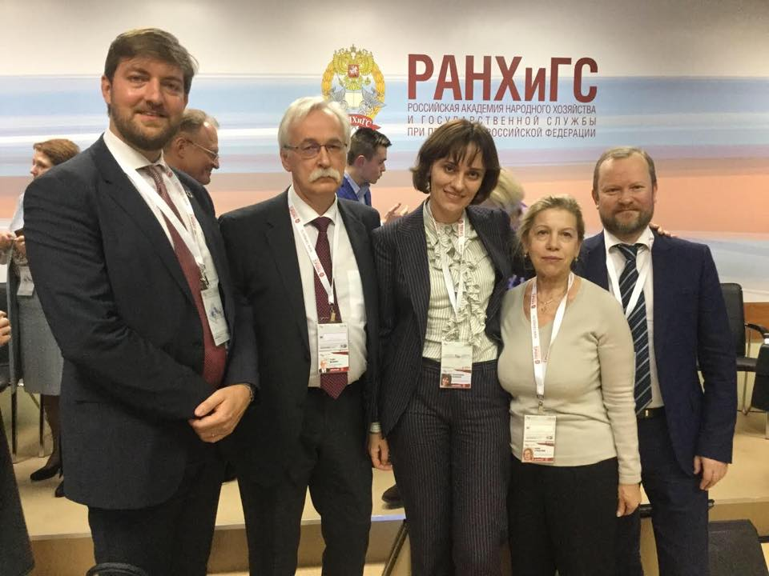
PRME – Russia
„Achieving the Global Agenda 2030 through responsible management education“
photo
photo
Source: http://www.unprme.org & Gaidar-Forum, 2018
Dr. Ekaterina Ivanova – LEAP, UN PRME Working Group on Sustainability Mindset

Slide 7
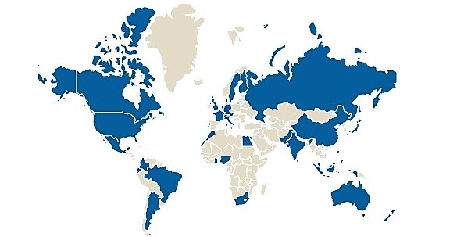
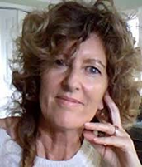
UN PRME Working Group on Sustainability Mindset
LEVERAGING RESOURCES, EXPANDING AWARENESS, ACCELERATING CHANGE AND PARTNERING
5
continents
Community –
over 100 members
Co-operative leader –
Dr. Isabel Rimanoczy
Dr. Ekaterina Ivanova – LEAP, UN PRME Working Group on Sustainability Mindset
Notes:
universities fail to recognize the strategic potential of deeply integrating SiME into their core value propositions as a fundamental principle of curricula (p.45)

Slide 8
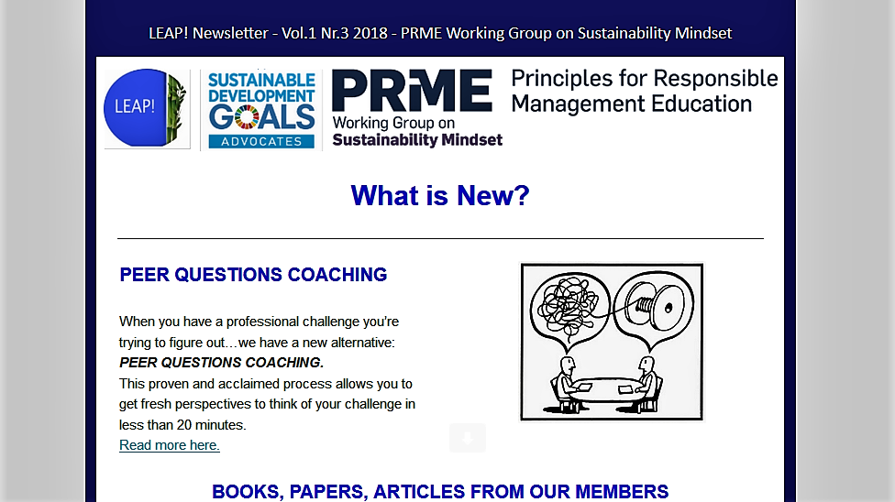

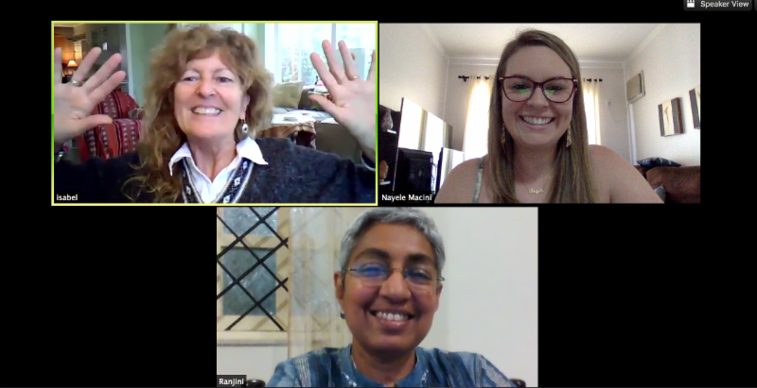
UN PRME Working Group on Sustainability Mindset
Newsletter
LEAP-Cafe
LEAP-Story Telling Circle
Annual pre-AOM Retreat
SM Award Winning Book
LEAP Training of Trainers
Ambassadors
Outreach Activities
Social Media Influence
Inspiring Community
MSR @ AOM
Dr. Ekaterina Ivanova – LEAP, UN PRME Working Group on Sustainability Mindset
Notes:
universities fail to recognize the strategic potential of deeply integrating SiME into their core value propositions as a fundamental principle of curricula (p.45)

Slide 9
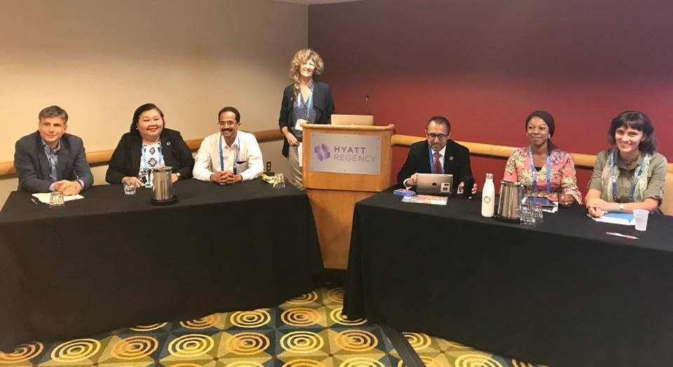
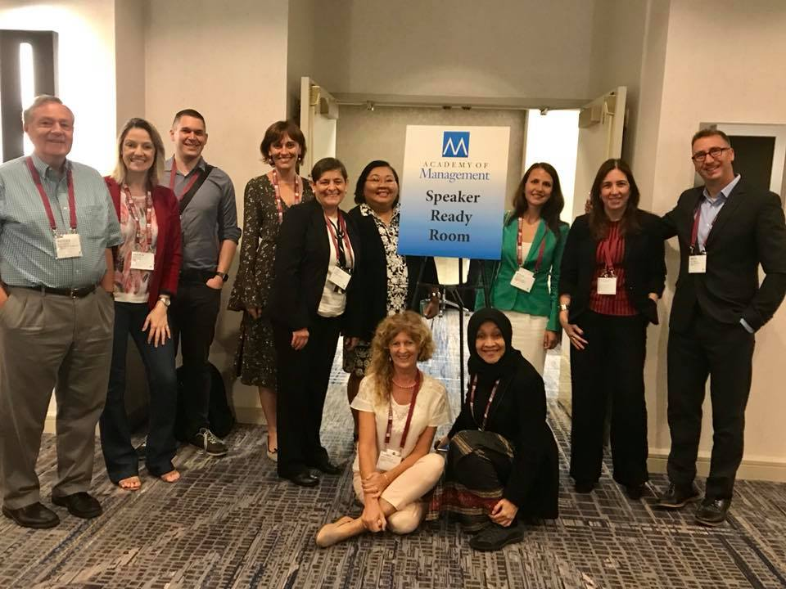
We are Challenging the Dominant Economistic Model
LEAP Pre-AOM Retreats & AOM PDWs build a fascinating community!
Dr. Ekaterina Ivanova – Integrating CSR & Sustainability in Management Education

Slide 10
WHY?
Екатерина Иванова
16 октября 2018, Москва

Slide 11
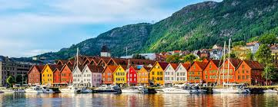

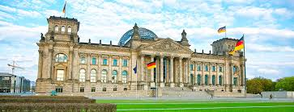

New Mainstream – Global Sustainability Leaders
Green Managerial Ideology
Across Scandinavia, DACH & Japan
Cooperation strategies to tackle
the Global Goals
+ Canada
+ New Zealand
Dr. Ekaterina Ivanova – LEAP, UN PRME Working Group on Sustainability Mindset
Notes:
universities fail to recognize the strategic potential of deeply integrating SiME into their core value propositions as a fundamental principle of curricula (p.45)

Slide 12

Who Publishes on CSR/Sustainability in Russia in Quality Management Journals in English?
International scholars
Igor Filatotchev, Alexandre Ardichvili,
Andrei Kuznetsov, Anna Zueva-Owens,
Anna-Maija Matilainen, Daniel McCarthy,
Inna Blam, Irina Soboleva, Jenny Fairbrass,
Jo Crotty, Julia Rozanova , Lutz Preuss,
Marc Fetscherin, Maryna Pobizhan,
Matthias S. Fifka, Olga Kuznetsova,
Peter Rodgers, Ralf Barkemeyer, Richard Warren,
Sergey Filippov, Sheila Puffer, Subhasis Ray,
Alex Settles, Veronika Bashtovaya
Russian scholars
Yuri Blagov, Leonid Polishchuk , Vladimir Avtonomov, Maxim Storchevoy, Zhanna Belyaeva, Anastasia Okorochkova, Anastasia Petrova-Savchenko, Sofia Villo
Research GAP for
an authentic voice of Russian scholars!!!
Dr. Ekaterina Ivanova – LEAP, UN PRME Working Group on Sustainability Mindset
Notes:
Anna Svirina
Gulnara Khadiullina
Irina Glebova
Dmitry Rodnyansky
Ruslan Sadyrtdinov
Rezeda Khabibrakhmanova
Yana Yasnitskaya

Slide 13
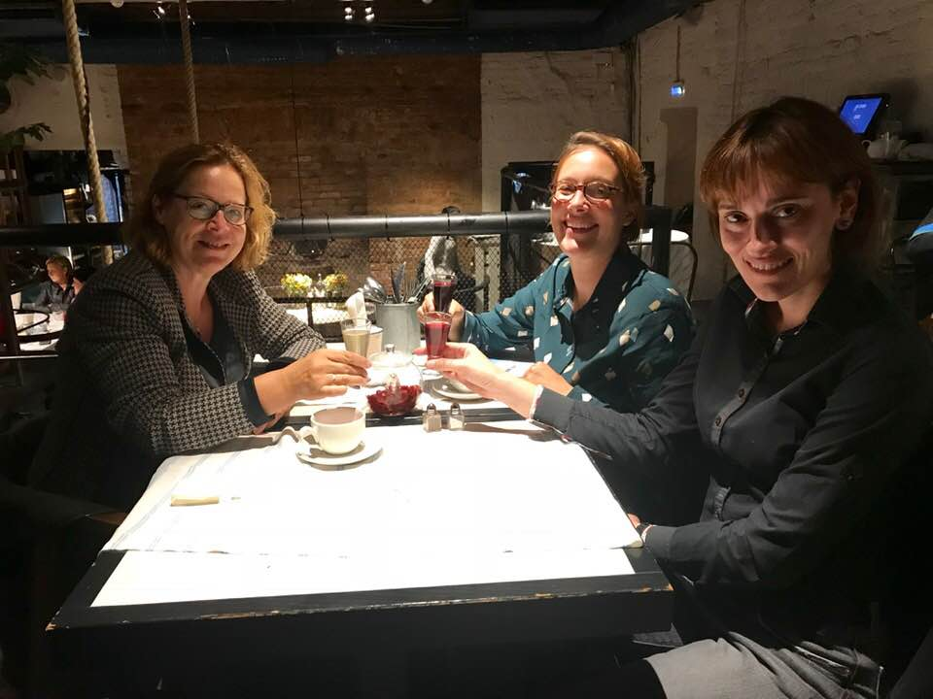
Germans in Russia: a new study on CSR is coming
Dr. Ekaterina Ivanova – LEAP, UN PRME Working Group on Sustainability Mindset
Notes:
Anna Svirina
Gulnara Khadiullina
Irina Glebova
Dmitry Rodnyansky
Ruslan Sadyrtdinov
Rezeda Khabibrakhmanova
Yana Yasnitskaya

Slide 14

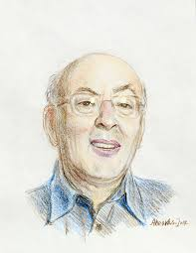
Management as a practice: science + craft + art
Management is a practice where
science (analysis),
craft (experience)
and art (imagination)
meet.
Source: Mintzberg, H. (2009). Managing. San Franscisco, CA: Berrett-Koehler Publishers.
Dr. Ekaterina Ivanova – LEAP, UN PRME Working Group on Sustainability Mindset
Notes:
Anna Svirina
Gulnara Khadiullina
Irina Glebova
Dmitry Rodnyansky
Ruslan Sadyrtdinov
Rezeda Khabibrakhmanova
Yana Yasnitskaya

Slide 15
HOW?
Dr. Ekaterina Ivanova
20 August 2018, Vienna

Slide 16
Teaching CSR & Sustainability in Russia: Problems
Discipline & attendance: low & late students
Home readings: only the most diligent do
Group projects: little experience & free riders
Communication: very informal & personalized
Deadlines: few are meeting up to 100%
16
Dr. Ekaterina Ivanova – LEAP, UN PRME Working Group on Sustainability Mindset

Slide 17
Teaching CSR & Sustainability in Russia: Opportunities
Creativity: visualization & sense of humor
Empathy: high affinity to purpose & passion
Reflection: depth & interconnectedness
Social media: connections & publicity
Proactiveness: job recommendations
17
Dr. Ekaterina Ivanova – LEAP, UN PRME Working Group on Sustainability Mindset

Slide 18
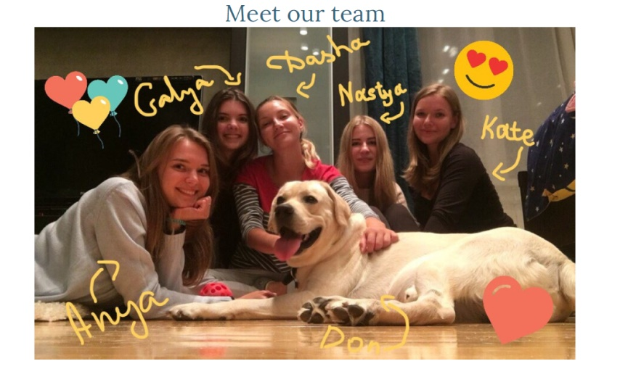
1. Team Charters as a Group Management Tool
Dr. Ekaterina Ivanova – LEAP, UN PRME Working Group on Sustainability Mindset

Slide 19
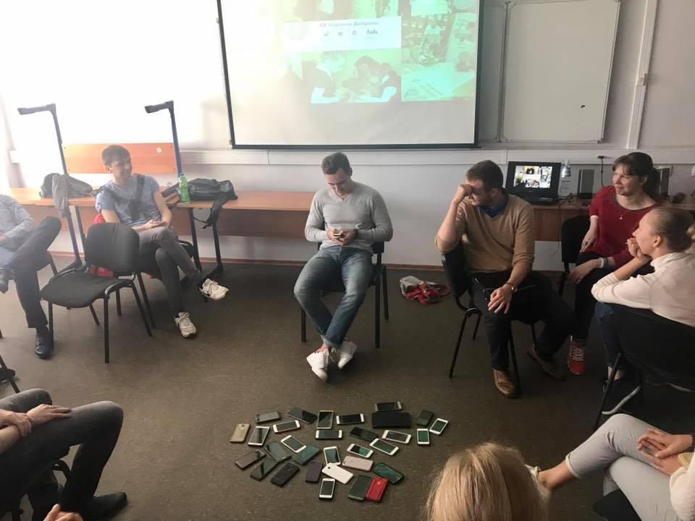
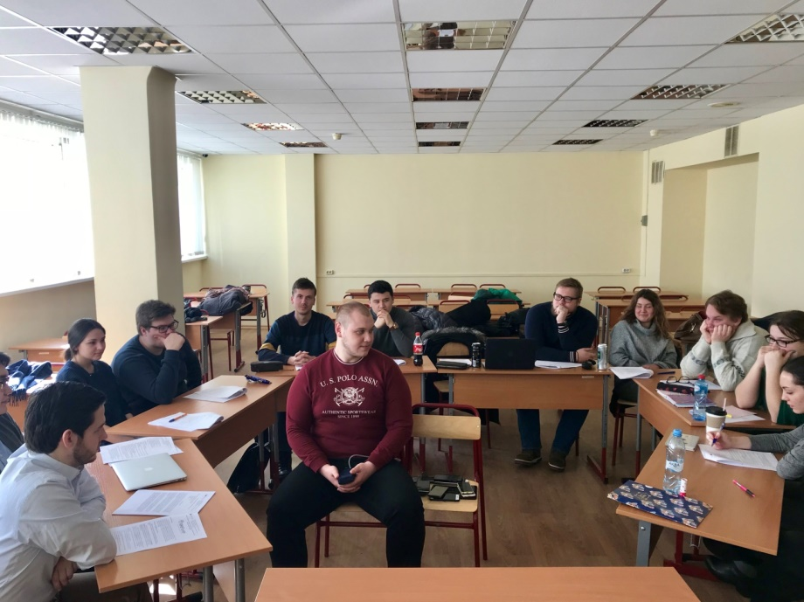
2. Class-room Setting and Unexpected Tasks: Pausing & Focus on Being vs. Doing
Dr. Ekaterina Ivanova – LEAP, UN PRME Working Group on Sustainability Mindset

Slide 20
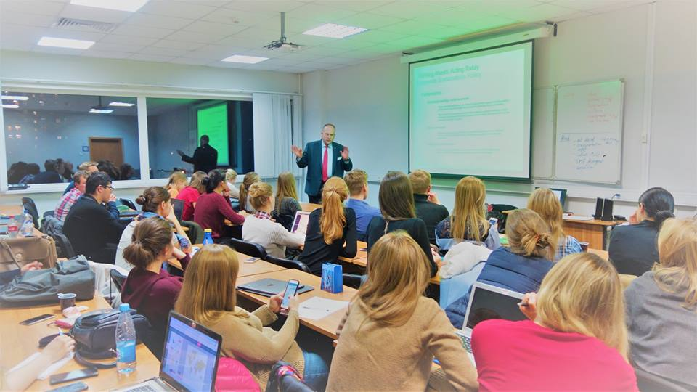
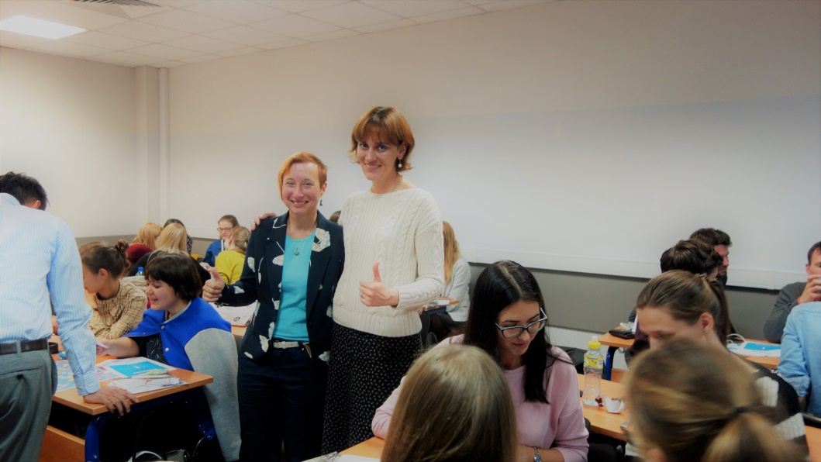
3. Influencial Guest-Speakers: Tasks + Reflections
Andrey Bykov,
CEO, Schindler-Russia
Natalia Malashenko,
Stakeholder Relations Director, UPM
Dr. Ekaterina Ivanova – LEAP, UN PRME Working Group on Sustainability Mindset

Slide 21
4. E-Portfolio: Nature + Sustainability + Art
Dr. Ekaterina Ivanova – LEAP, UN PRME Working Group on Sustainability Mindset

Slide 22
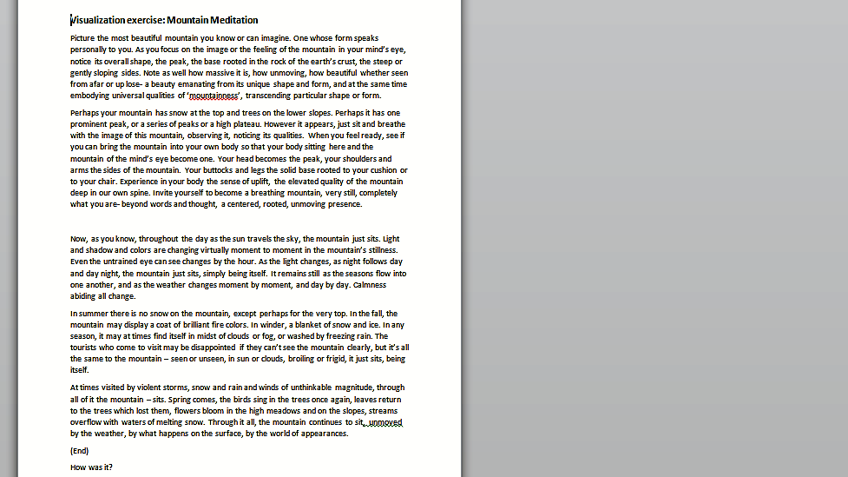
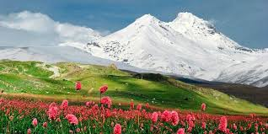
5. Meditation in Class! YES, I Tried it!!! It Works!!!
Dr. Ekaterina Ivanova – LEAP, UN PRME Working Group on Sustainability Mindset

Slide 23
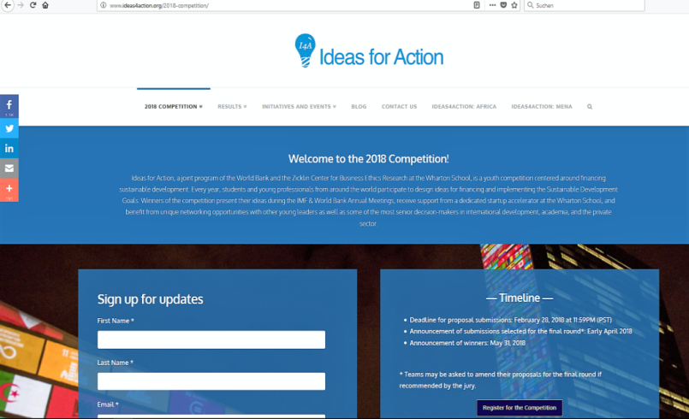

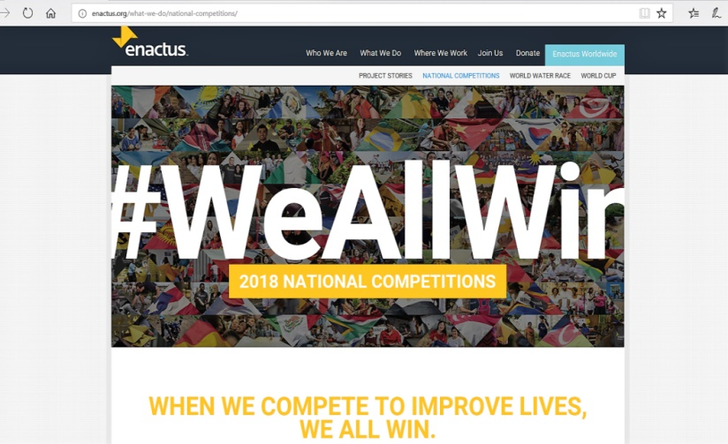
6. Implementing the Global Goals – Get Involved Globally or Locally !
Dr. Ekaterina Ivanova – LEAP, UN PRME Working Group on Sustainability Mindset

Slide 24

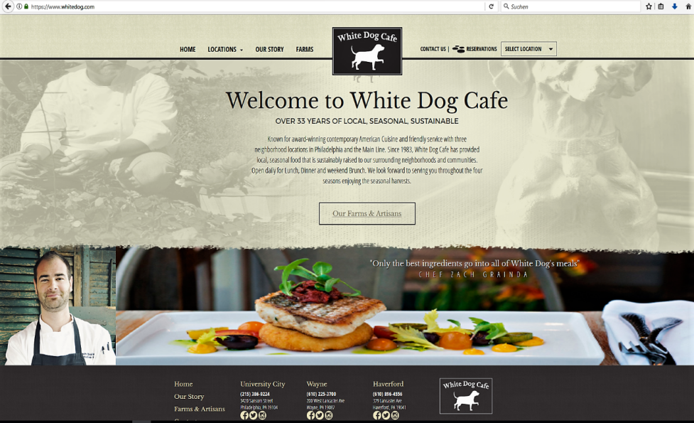

7.1 Judy Wicks – A global role model in sustainable biz
Dr. Ekaterina Ivanova – LEAP, UN PRME Working Group on Sustainability Mindset

Slide 25
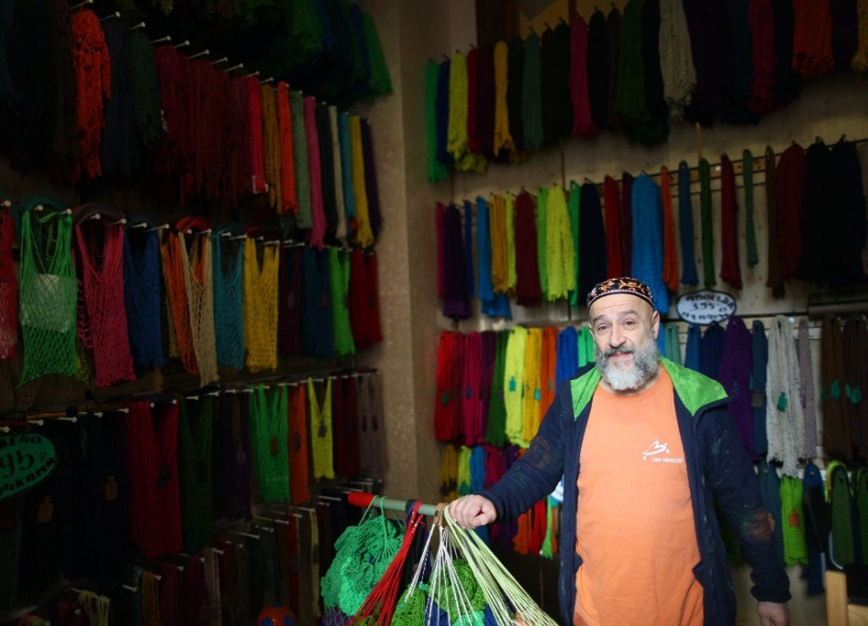
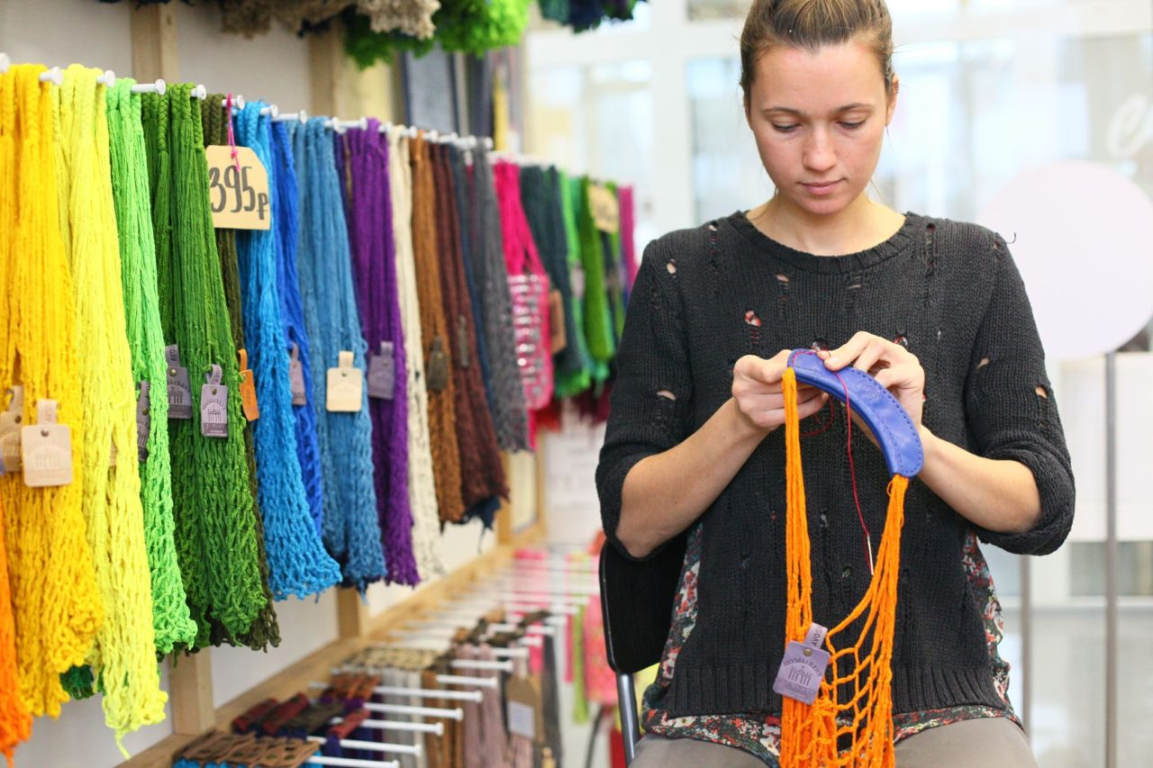

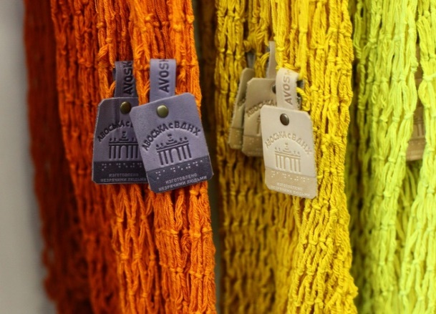
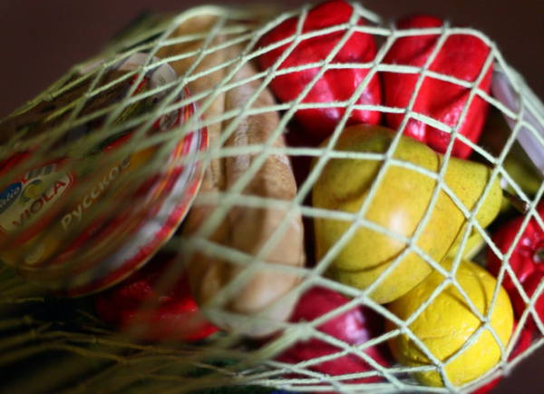
7.2 Sustainability Heros as Role Models – E. Rappaport
Source: https://takiedela.ru/2016/11/avos-malenkogo-cheloveka/
Dr. Ekaterina Ivanova – LEAP, UN PRME Working Group on Sustainability Mindset

Slide 26
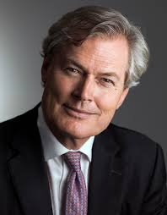
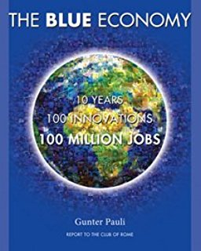
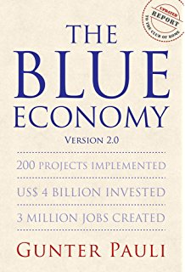






7.3 Prof. Gunter Pauli – “Steve Jobs of Sustainability”
Dr. Ekaterina Ivanova – LEAP, UN PRME Working Group on Sustainability Mindset
Notes:
GUNTER PAULI is a born entrepreneur whose scope of initiatives spans business, culture, science and education. In 1994, with the support of the Japanese government and the United Nations University, he launched an initiative to design an economic framework and business model that converts all waste, including emissions, into a value-added cascade, modelled on ecosystems. In 2004, he launched a research project identifying the innovations that will shift business towards higher levels of competitiveness and sustainability, while generating millions of jobs through the creation of a platform for entrepreneurship. In early 2010, he personally directed a two-year initiative that each week for 100 weeks presented another business model to inspire entrepreneurs to translate these opportunities into worldwide business initiatives. Pauli is the author of 17 books published in 21 languages, and of 36 fables that bring science and entrepreneurship to children at an early age. The Blue Economy / Version 2.0 outlines how to go beyond green, generating multiple cash flows, reducing risk and embracing break-throughs that shift the business model to a competitive framework where entrepreneurs respond to local needs with what is locally available.

Slide 27
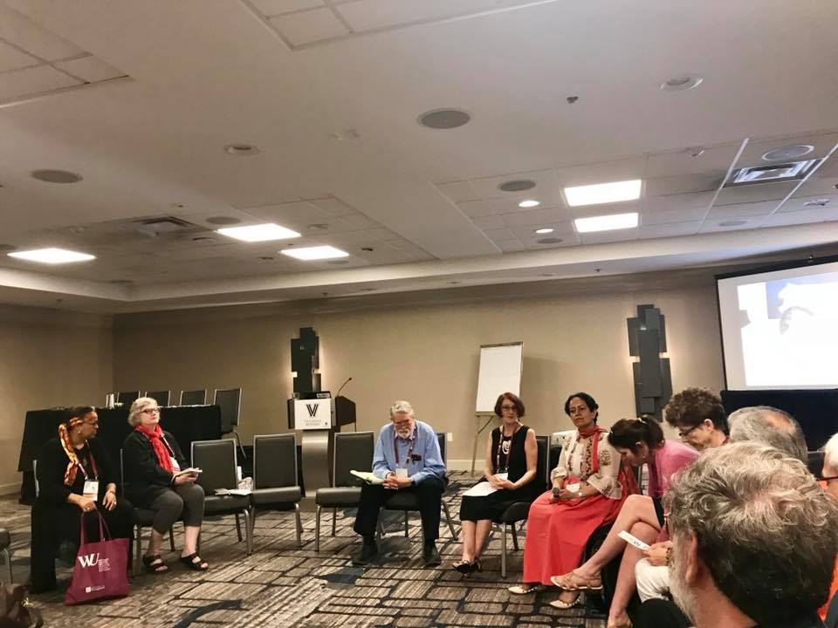

7.4. Prof. David Korten – Local Living Economies
No plan in life
Importance of informal conversations
Change in doing business will come with a new movement lead by China
Dr. Ekaterina Ivanova – LEAP, UN PRME Working Group on Sustainability Mindset

Slide 28

8.1 From PRME to Aim2Flourish.com
At the 2015 PRME Global Forum – launch of the Aim2Flourish platform
Aim2Flourish – the world’s first higher-education curriculum, story platform, and prize for the Global Goals
Aim2Flourish – an initiative of the Fowler Center for Business as an Agent of World Benefit at the Weatherhead School of Management —Case Western Reserve University
Dr. Ekaterina Ivanova – LEAP, UN PRME Working Group on Sustainability Mindset

Slide 29
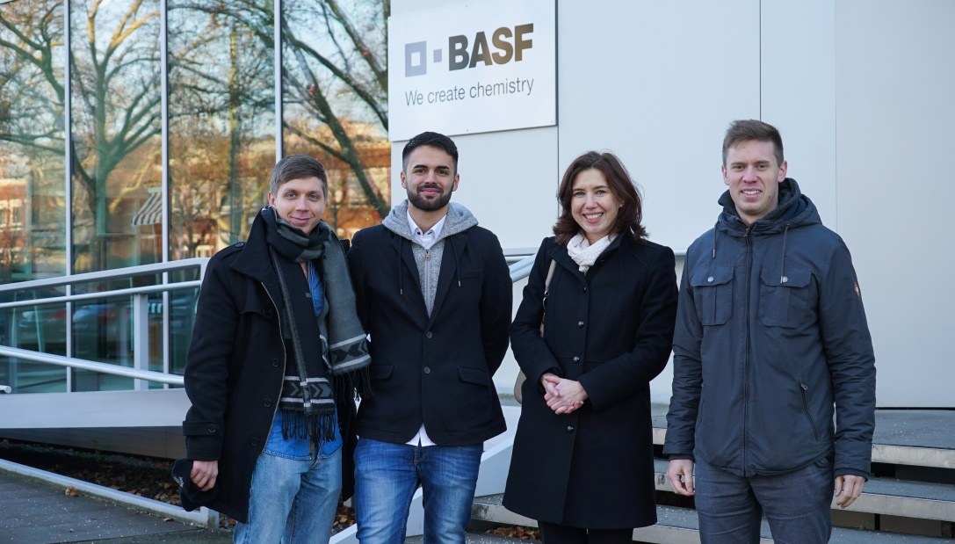
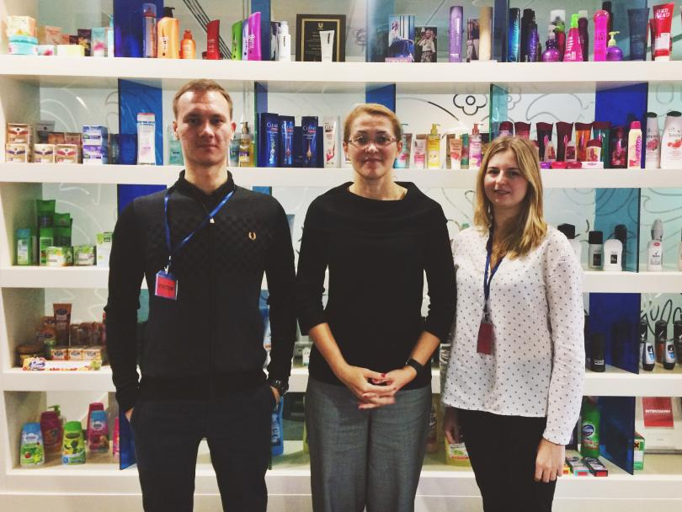
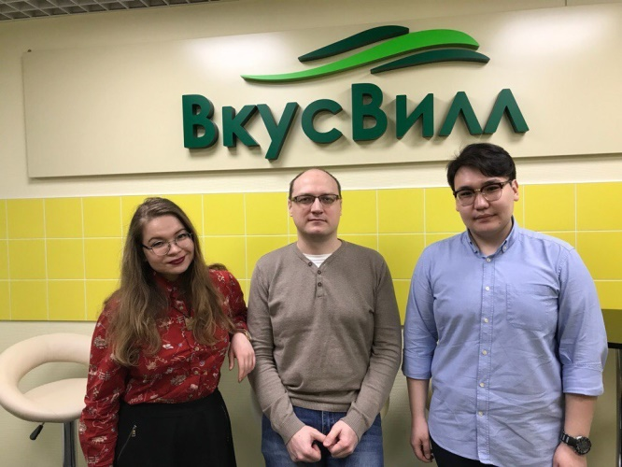



8.2. Interviewing using Appreciative Inquiry Method
Dr. Ekaterina Ivanova – LEAP, UN PRME Working Group on Sustainability Mindset

Slide 30
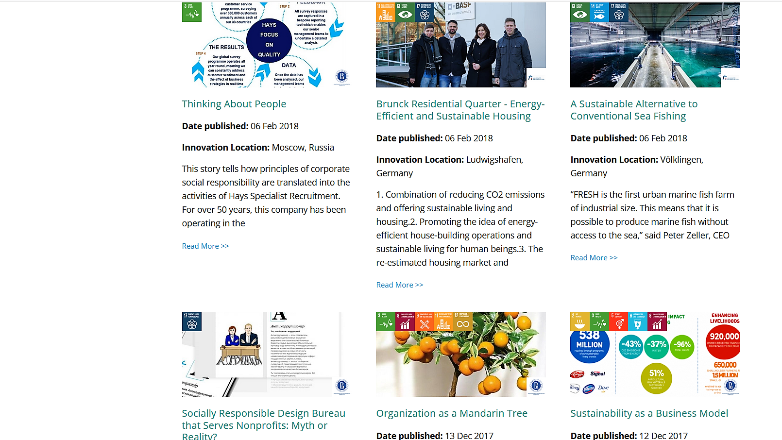

8.3 - 23 Sustainable Innovation Stories
from Russia & Germany for AIM2Flourish.com
Dr. Ekaterina Ivanova – LEAP, UN PRME Working Group on Sustainability Mindset

Slide 31
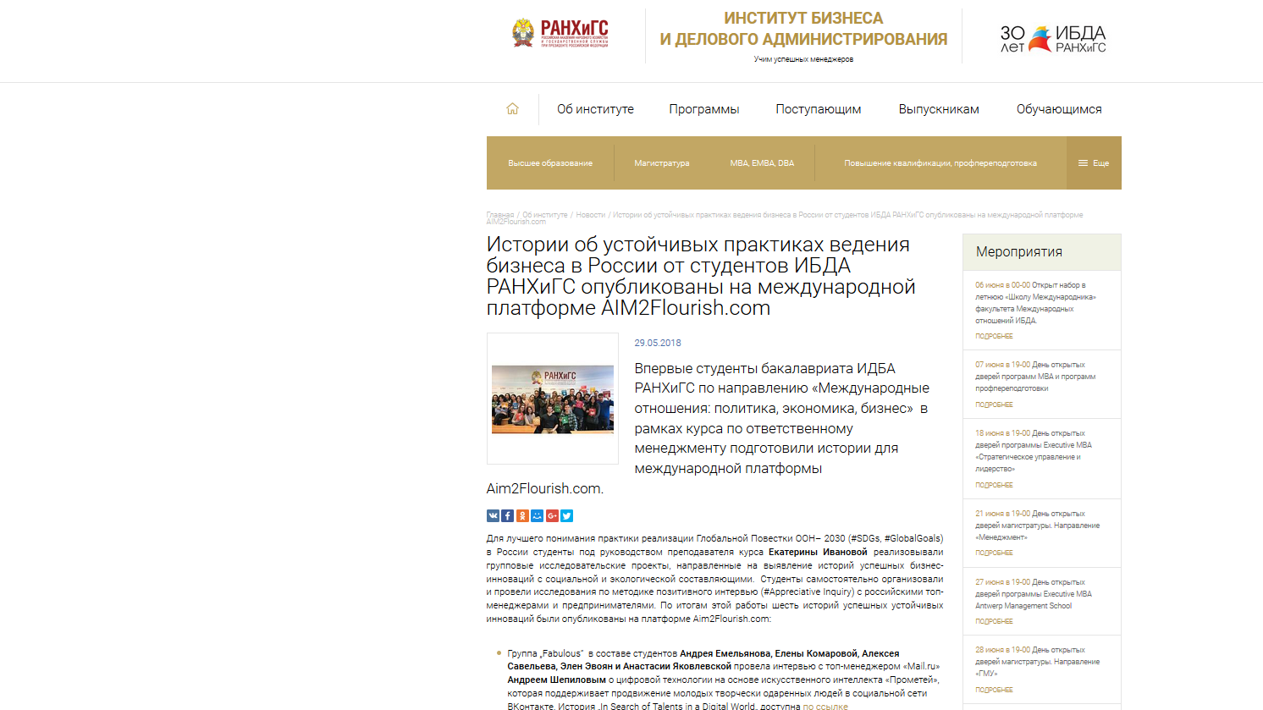
8.4 University Website: Promoting Aim2Flourish Stories
Knowing +
Being +
Doing
=
Sustainability
Mindset
Dr. Ekaterina Ivanova – LEAP, UN PRME Working Group on Sustainability Mindset

Slide 32
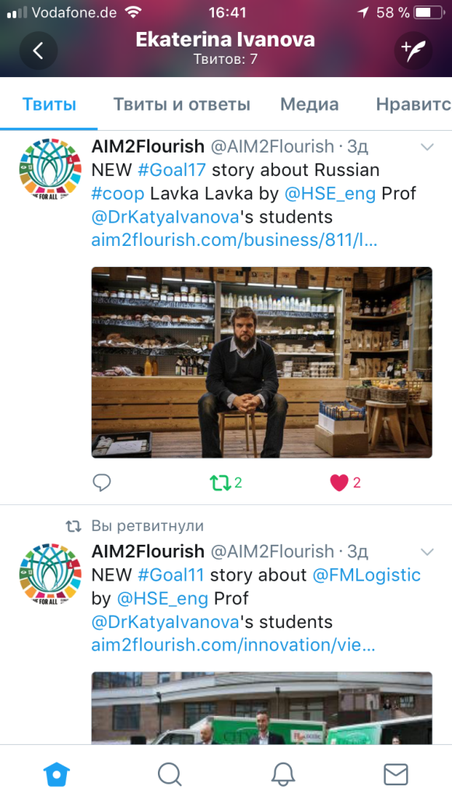
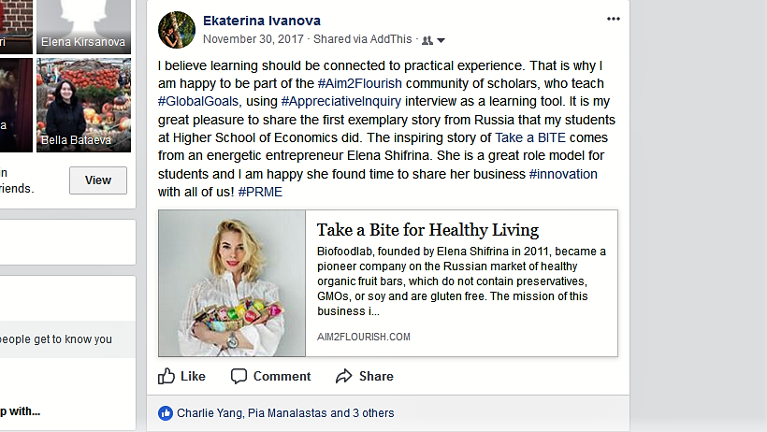
8.5 Promoting Aim2Flourish Stories on Social Media
Dr. Ekaterina Ivanova – LEAP, UN PRME Working Group on Sustainability Mindset

Slide 33

8.8 Students Reflecting on Aim2Flourish
“We are under a great impression of Artem Agabekov's ideas - he inspired us to think "out of the box" and deeper than we used to. As we are doing our course in the field of management it was crucial for us to learn that we should not think about employees like resources but we should consider them as fountains of inspiration for organizational development”.
Oct 18, 2017
Dr. Ekaterina Ivanova – LEAP, UN PRME Working Group on Sustainability Mindset

Slide 34

9. Humor in Class: #Globalgoals - @GoodLifeGoals ☺
Source: https://www.linkedin.com/feed/update/urn:li:activity:6398799971113590784
Dr. Ekaterina Ivanova – LEAP, UN PRME Working Group on Sustainability Mindset

Slide 35
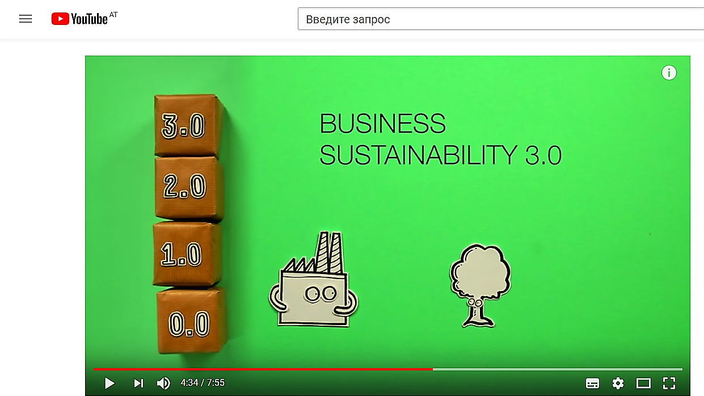
10. COOL videos: TRUE Business Sustainability 3.0
photo
photo
Source: https://www.youtube.com/watch?v=AEFqUh4PMmI & MORE on „Little Green Bags“ http://youtu.be/E0NkGtNU_9w
Dr. Ekaterina Ivanova – LEAP, UN PRME Working Group on Sustainability Mindset

Slide 36
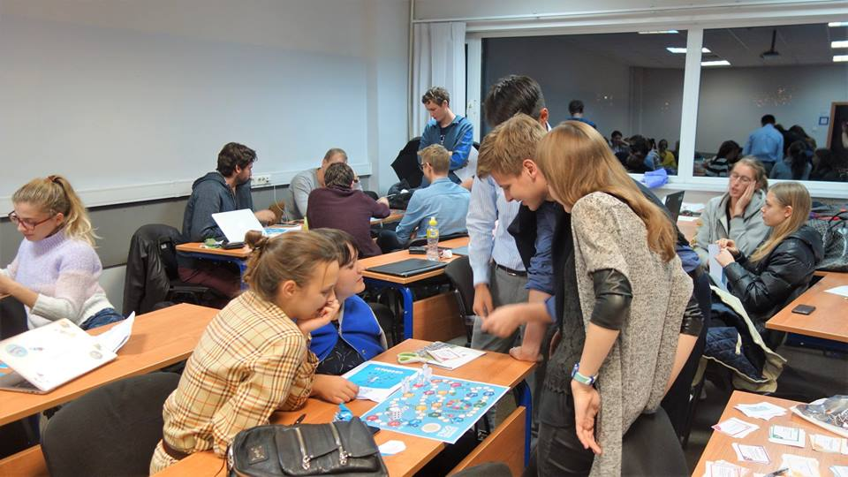
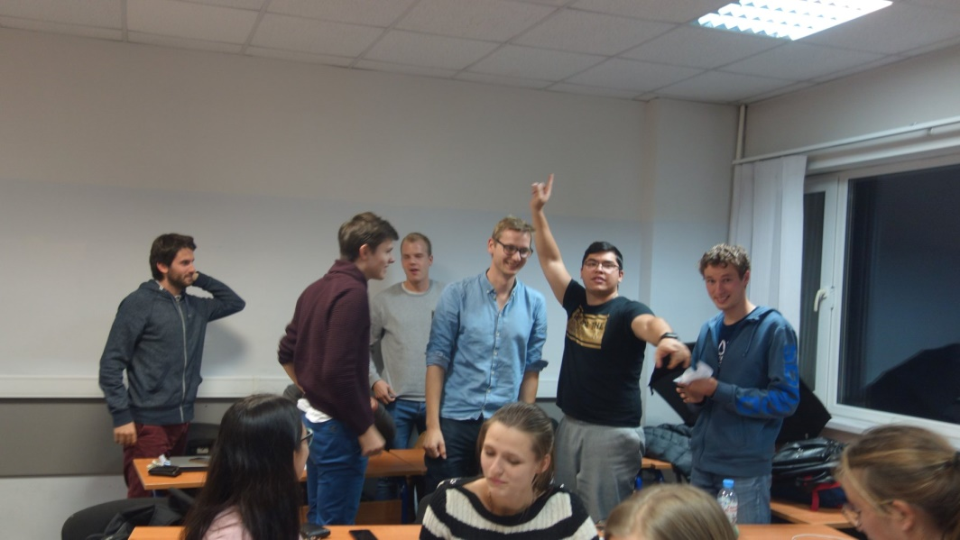
11. Playing Games on SDGs
photo
photo
https://go-goals.org
Dr. Ekaterina Ivanova – LEAP, UN PRME Working Group on Sustainability Mindset

Slide 37
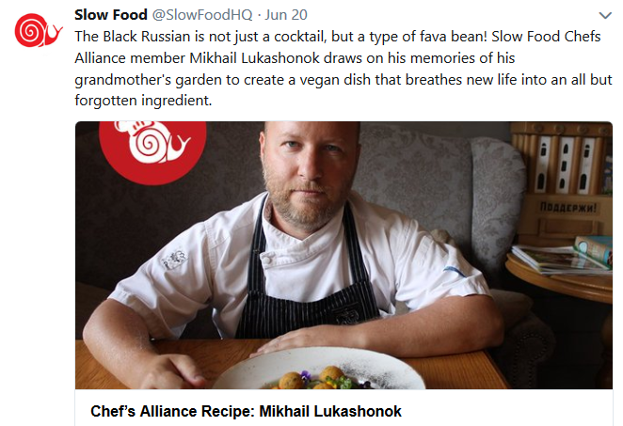
12. Sustainable Life-Style „Less is More!”
#SlowLife
#SlowFood
#SlowTravel
#SlowEducation
#SlowFashion
#SlowMoney
#SlowBusiness
Source: Slow Food, 2018
Dr. Ekaterina Ivanova – LEAP, UN PRME Working Group on Sustainability Mindset

Slide 38

13. Movies to Watch Outside of Class
Source: YouTube
Dr. Ekaterina Ivanova – LEAP, UN PRME Working Group on Sustainability Mindset
Notes:
universities fail to recognize the strategic potential of deeply integrating SiME into their core value propositions as a fundamental principle of curricula (p.45)

Slide 39
SO WHAT?
Екатерина Иванова
16 октября 2018, Москва

Slide 40
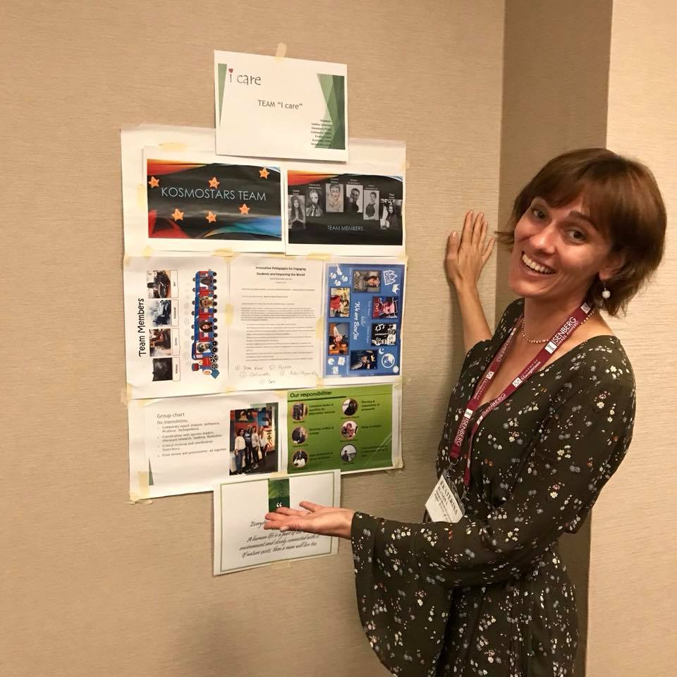
Is it me or what I teach that works for students?
Dr. Ekaterina Ivanova – LEAP, UN PRME Working Group on Sustainability Mindset
Notes:
universities fail to recognize the strategic potential of deeply integrating SiME into their core value propositions as a fundamental principle of curricula (p.45)

Slide 41
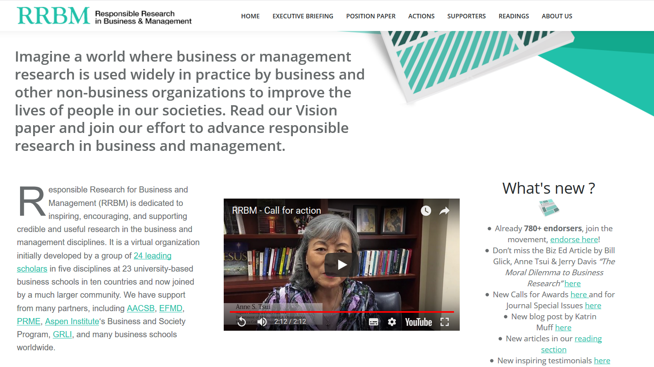
A Leading Global SiME Initiative by Academics to Make Management Relevant for Society
Dr. Ekaterina Ivanova – Integrating CSR & Sustainability in Management Education
Notes:
a metanoia shift in management education is blocked because universities themselves are stuck in a ‘business as usual’ paradigm, competing on dysfunctional rating games that focus on ‘excellence’ over impact. P.47

Slide 42
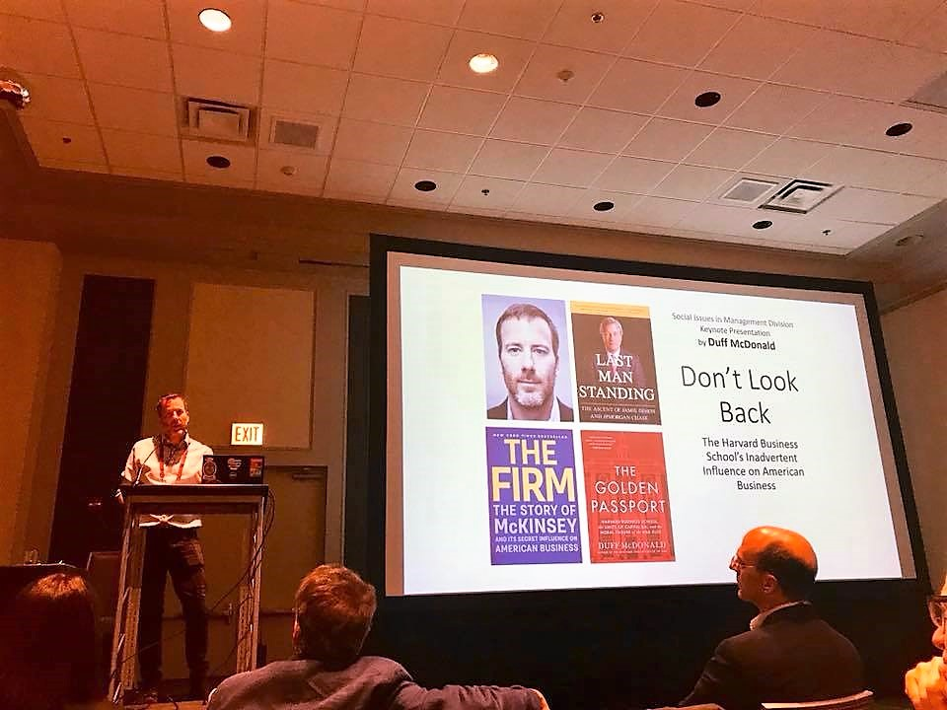
Duff McDonald – a Brave Journalist on Awakening!
Dr. Ekaterina Ivanova – Integrating CSR & Sustainability in Management Education
Notes:
the five goals of sustainability
Resource conservation
Built environment
Environment quality
Social equality
Political participation
(Blowers, 1991).

Slide 43
Take-away messages
Humanistic Management and Sustainability Mindset is what millennials want to learn
Green Campus is the best way to signal engagement with sustainability university-wide
Continue to do innovative research, pedagogies and outreach activities with the best people doing right things across the fields
Stay part of something bigger: UN PRME, AOM, LEAP
Be authentic & serve a living role model of what you teach!
Dr. Ekaterina Ivanova – Integrating CSR & Sustainability in Management Education

Slide 44
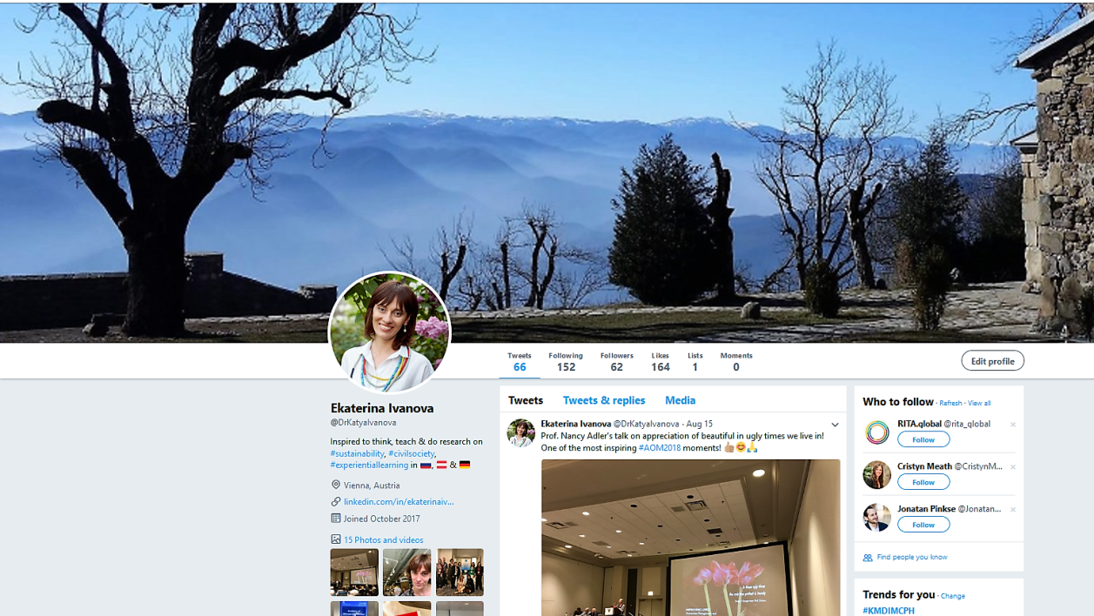
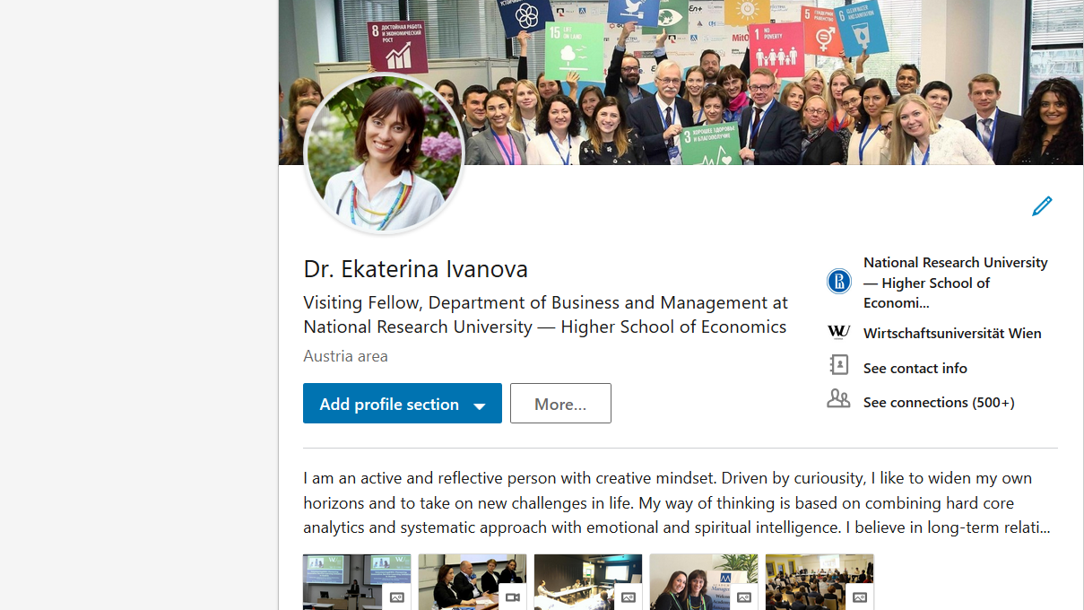
Let’s keep in touch!
dr.ekaterina.ivanova@gmail.com
https://at.linkedin.com/in/ekaterinaivanova
@DrKatyaIvanova
Dr. Ekaterina Ivanova – Responsible Management: Developing a Sustainability Mindset

Slide 45
Thank you for your attention!

